Slide 1
FASTAPI Development using Python on Cloud
FastAPI with Agentic AI on Cloud

Slide 2
Overview of Pydantics
Python library used for data modelling , data parsing and has efficient error handling.
Pydantics commonly used as a resource for data validation and how to handle data coming to FastAPI application.

Slide 3
Pydantic Benefits
Powered by type hints – with Pydantics, schema validation, serialization are controlled by type annotations.
Fast –Pydantics core validation is written in Rust. One of the fastest data validation library in Python.
Json Schema- Pydantic model emits JSON schema allowing for easy integration
DataClasses – Pydantic supports validation of many standard libraries like dataclass and typedDict
Customization – Allows custom validators and serializers to alter how data is processed.
Ecosystem –Around 8000 packages on PyPI uses Pydantic & massively popular over Langchain, Huggingface, FastAPI, SQLModel etc.

Slide 4
HTTP Status Codes
FastAPI
​Web Page
Full Stack Application
Server
An HTTP Status Code is used to help the Client to understand what happened on the Server side application
Status Codes are international standards on how a Client/Server should handle the result of a request.
It allows everyone who sends a request to know if their submission is successful or not.

Slide 5
Status Codes
1xx
Information Response: Request Processing.
2xx
Success: Request Successfully complete
3xx
Redirection: Further action must be complete
4xx
Client Errors: An Error was caused by the Client
5xx
Server Errors: An error occurred on the server

Slide 6
2xx Successful Status Codes:
200: OK
Standard response for a successful request. Commonly used for successful Get requests when data is being returned.
201
The request has been successful. Creating a new resource. Used when a POST creates an entity.
204: No
The request has been successful, did not create an entity nor return anything. Used mainly with PUT request.

Slide 7
4xx Client Errors Status Codes:
400: Bad
Can’t process request due to client error. Commonly used for invalid request methods.
401: Unauthorized
Client does not have valid authentication for target resource
404: Not
The clients requested resource can’t be found
422: Unprocessable
Semantic Errors in Client Request

Slide 8
HTTP 5xx Server Error Status Codes
500: Internal Server Error
Generic Error Message, when an expected issue on the server happened.

Slide 9
Setting Up SQL database
Organized collection of structural information of data, which’s stored in Cloud, container or server.
The data can easily retrieve.
The data can be modeled.
A database is collection of data.
Database are organized in how data can be retrieved, stored or modified.

Slide 10

SQL Details
Query
DBMS
Table
Create
POST
Read
Get
Update
PUT
Delete
Delete

Slide 11
Alembic & SQLAlchemy
Lightweight database migration tool for when using SQLAlchemy
Migration tools allow us to plan, transfer and upgrade resources within databases
Alembic allows to change a SQLAlchemy database table after it has been created.
Currently SQLAlchemy will only create new database tables.
Alembic provides the creation and invocation of change management scripts.
It allows to able to crate migration environments and be able to change the data
It works on tables which already have data. It allows to continually create additional content which works within the application.

Slide 12
Running Your SQLModel
SQLModel is built on top of SQLAlchemy and Pydantic. It was made by the same author of FastAPI to be the perfect match for FastAPI applications that need to use SQL databases.
As SQLModel is based on SQLAlchemy, you can easily use any database supported by SQLAlchemy (which makes them also supported by SQLModel), like:
PostgreSQL
MySQL
SQLite
Oracle
Microsoft SQL Server, etc.

Slide 13

Install SQLModel
First, make sure you create your virtual environment, activate it, and then install sqlmodel:Path Parameters are defined as a way to find information based on location

Slide 14
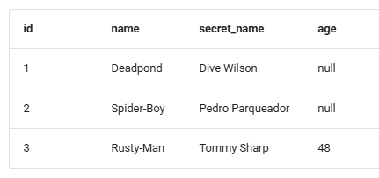
Create SQL Table with SQLModel
Imagine you have a SQL table called hero with:
id
name
secret_name
age

Slide 15
Create Model
from typing import Annotated
from fastapi import Depends, FastAPI, HTTPException, Query
from sqlmodel import Field, Session, SQLModel, create_engine, select
class Hero(SQLModel, table=True):
id: int | None = Field(default=None, primary_key=True)
name: str = Field(index=True)
age: int | None = Field(default=None, index=True)
secret_name: str

Slide 16
Session Dependency
Session is what stores the objects in memory and keeps track of any changes needed in the data, then it uses the engine to communicate with the database.
We will create a FastAPI dependency with yield that will provide a new Session for each request. This is what ensures that we use a single session per request.
Then we create an Annotated dependency SessionDep to simplify the rest of the code that will use this dependency.

Slide 17
The SQLModel Advantage
Since FastAPI is based on Pydantic, it will use the same model to use the automatic data validation and conversion from the JSON request to an object instance that has actual instance of HERO class.
SQLModel object is not only a Pydantic model instance but also SQLAlchemy model instance which we can use directly in a session to create new row in database.
We can use intuitive standard Python type annonation and we don’t have the duplicates code for the database models and the API data models.

Slide 18
Query Parameters
Query Parameters are request parameters which have been attached after a ”?”
Query Parameters have name=value pairs
Example – 127.0.0.1/books/?category=math

Slide 19
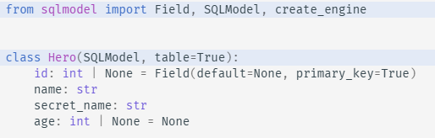
Create the table with SQLModel
Define a table with SQLModel
Create the same SQLite database and table with SQLModel
Use DB Browser for SQLite to confirm the operations

Slide 20
SQL Alchemy Connection - Engine
The start of any SQLAlchemy application is an object called the Engine. This object acts as a central source of connections to a particular database, providing both a factory as well as a holding space called a connection pool for these database connections.
The engine is typically a global object created just once for a particular database server and is configured using a URL string which will describe how it should connect to the database host or backend.

Slide 21
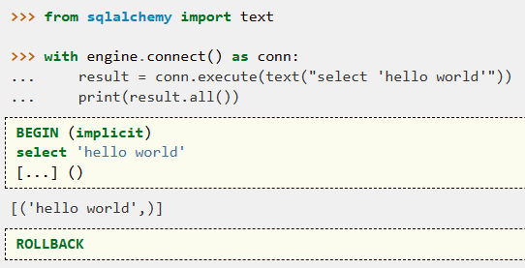
Getting the Connection with SQLAlchemy
The purpose of the Engine is to connect to the database by providing a Connection object. When working with the Core directly, the Connection object is how all interaction with the database is done.
Because the Connection creates an open resource against the database, we want to limit our use of this object to a specific context. The best way to do that is with a Python context manager, also known as the with statement.

Slide 22
Working with SQL DB API
Inserting Rows with Core - to get some data into the database.
INSERTs from an ORM perspective are described in the next section Data Manipulation with the ORM.
Selecting Rows with Core or ORM - The update() function generates a new instance of Update which represents an UPDATE statement in SQL, that will update existing data in a table.
Like the insert() construct, there is a “traditional” form of update(), which emits UPDATE against a single table at a time and does not return any rows. However, some backends support an UPDATE statement that may modify multiple tables at once, and the UPDATE statement also supports RETURNING such that columns contained in matched rows may be returned in the result set.

Slide 23
CRUD Operations with SQL API
If we just create the tables and the data as we have been doing, when we SELECT some data using WHERE, the database will have to scan through each one of the records to find the ones that match.
The engine is that single object that we share with all the code, and that is in charge of communicating with the database, handling the connections (when using a server database like PostgreSQL or MySQL), etc.
But when working with SQLModel you will mostly use another tool that sits on top, the Session.
In contrast to the engine that is one for the whole application, we create a new session for each group of operations with the database that belong together.

Slide 24
Indexing – SQL Query Optimization
If we just create the tables and the data as we have been doing, when we SELECT some data using WHERE, the database would have to scan through each one of the records to find the ones that match. This is not a problem with 3 heroes as in these examples.
But imagine that your database has thousands or millions of records, if every time you want to find the heroes with the name "Deadpond" it has to scan through all of the records to find all the possible matches, then that becomes problematic, as it would be too slow
Database indexes store some info, some keys, in a way that makes it easy and fast to find (for example sorted), and then for each key they point to some data somewhere else in the database.

